Slide 1
CIS 4930/6930-002 Data Visualization
VISUALIZING SETS
Paul Rosen
Assistant Professor
University of South Florida
slides credits Miriah Meyer (U of Utah)

Slide 2
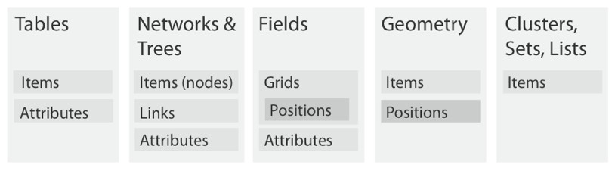
(hint: these are categorical data)

Slide 3

thought experiment…
item: lego
attributes:
???

Slide 4
thought experiment…
item: lego
attributes:
color
height
width
length
shape

Slide 5
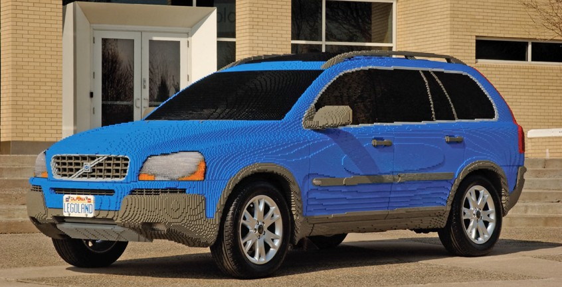
dataset

Slide 6
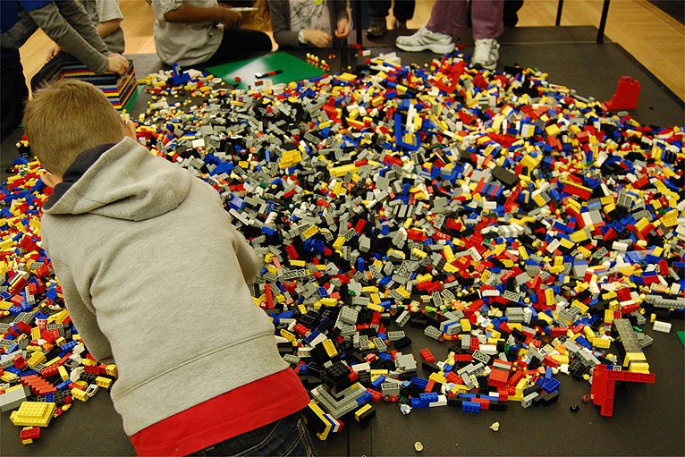
dataset: more realistic

Slide 7
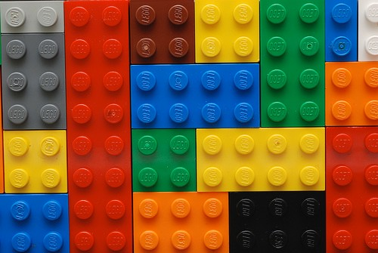
Dataset
where do we start?
we need to organize!
but, how?

Slide 8
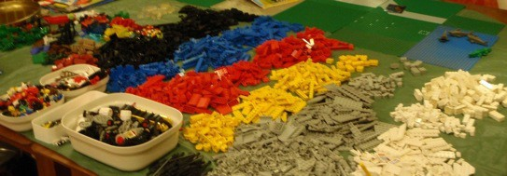
dataset
sort by color

Slide 9
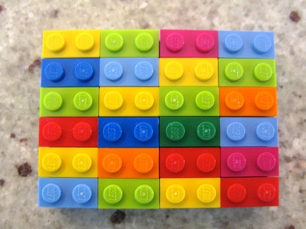
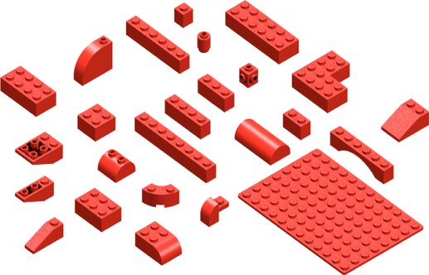
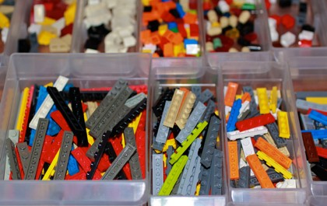
dataset
sort by size, shape

Slide 10
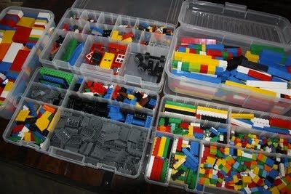
Dataset
task: organization
drawbacks?

Slide 11
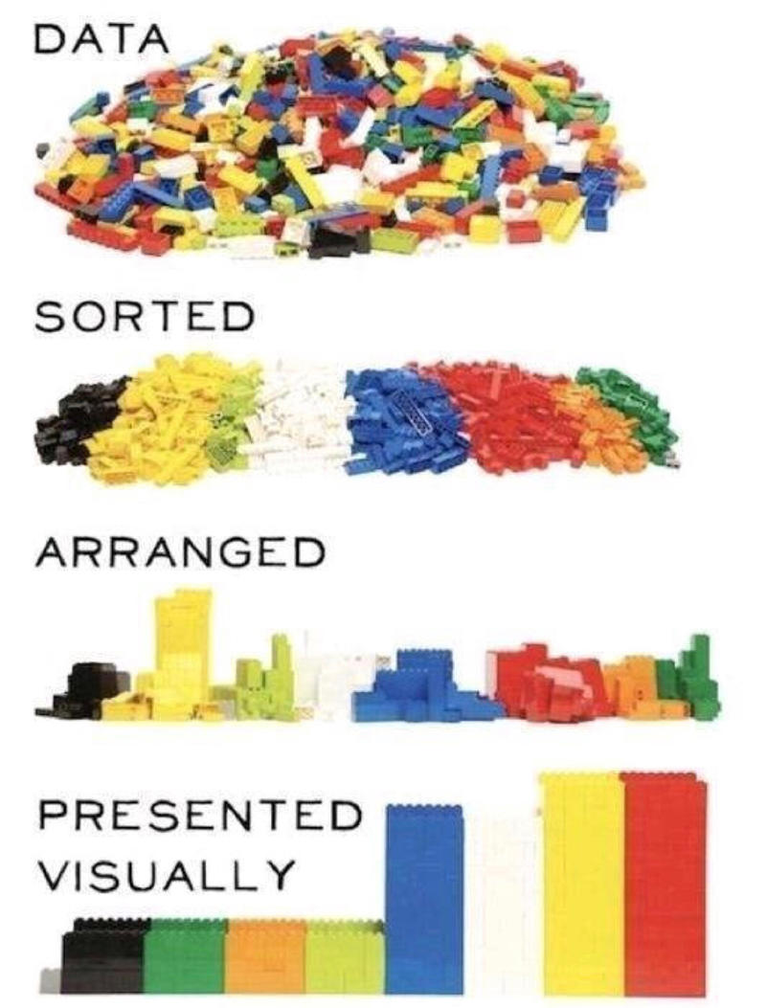
Set Challenge

Slide 12
Dataset
organization leads us to a set problem
so what are sets?

Slide 13
set theory
set
a collection of objects
some set: A
A

Slide 14
set theory
set
a collection of objects
some set: A
object
some object: z
z ∈ A
A
z

Slide 15
set theory
multiple sets: A & B
B
A

Slide 16
set theory
union: A ∪ B
B
A

Slide 17
set theory
intersection: A ∩ B
B
A

Slide 18
set theory
set difference: A \ B
B
A

Slide 19
set theory
symmetric difference: A ⊖ B
B
A

Slide 20
http://students.brown.edu/seeing-theory/index.html

Slide 21
visualizing sets

Slide 22
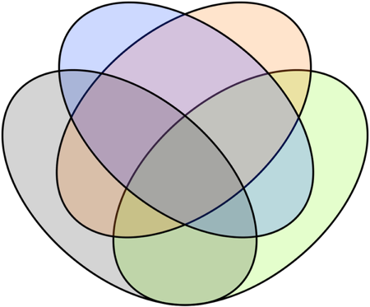
venn diagrams
show all possible relationships

Slide 23
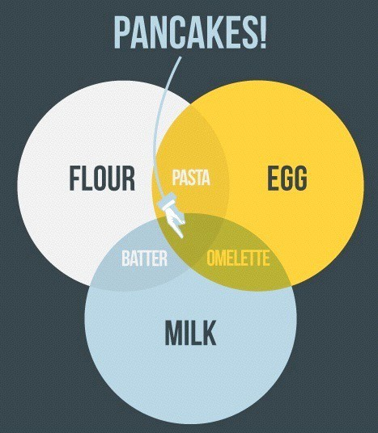
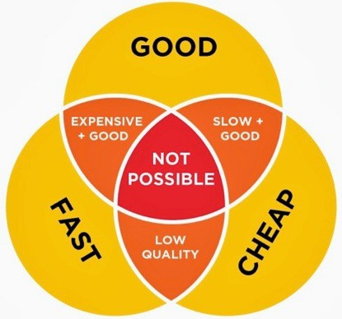
venn diagrams
“casual infovis”

Slide 24
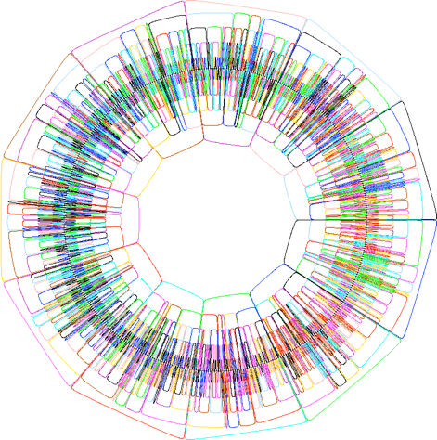
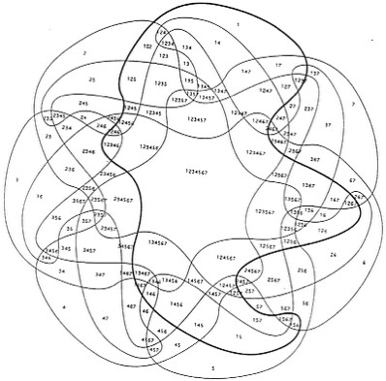
venn diagrams
get messy fast
11
7

Slide 25

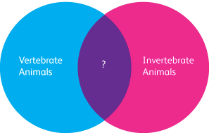
venn diagrams
non-sensical

Slide 26
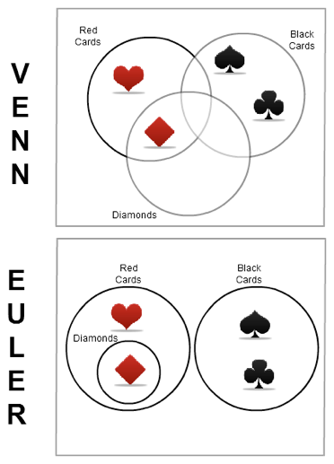
euler diagrams
show only existing relationships

Slide 27
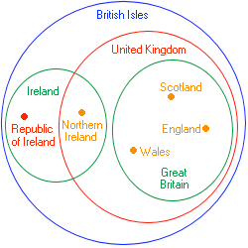
euler diagrams
show only existing relationships

Slide 28
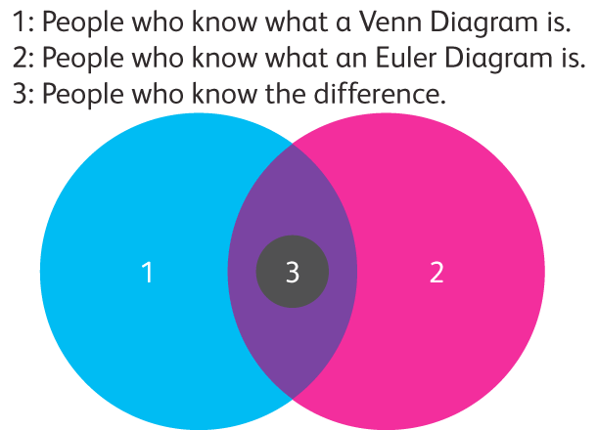
euler diagrams
Misunderstood

Slide 29
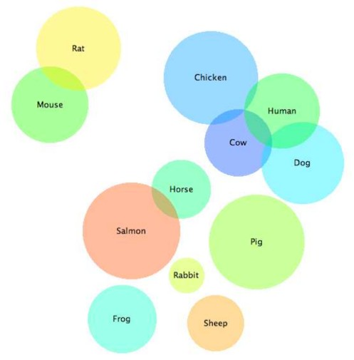
venn & euler diagrams
adjust for area
starts getting tricky!

Slide 30
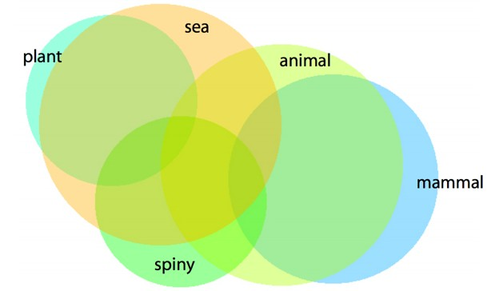
venn & euler diagrams
adjust for area
starts getting tricky!

Slide 31
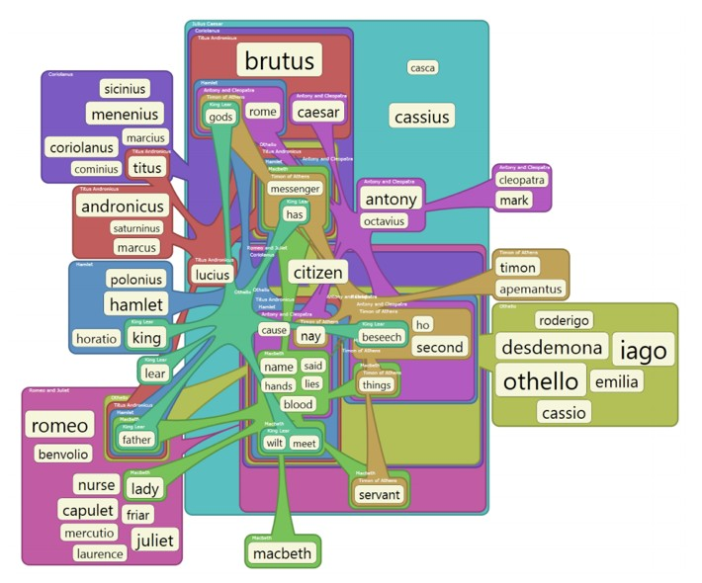
compact euler diagrams

Slide 32
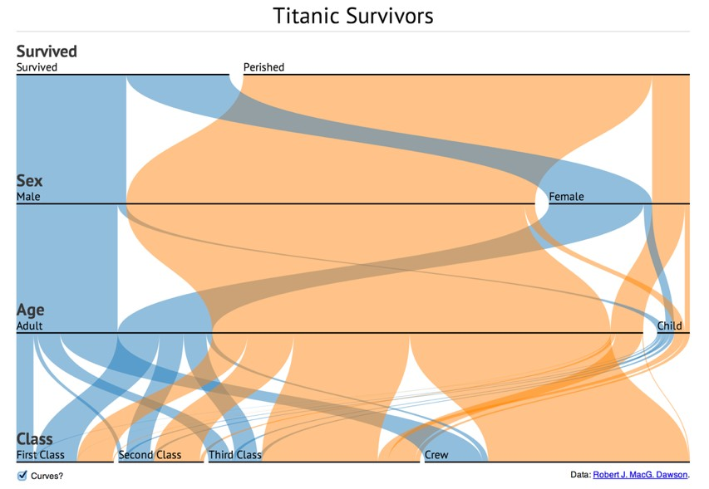
parallel sets

Slide 33
parallel sets
builds on PC to better handle categorical data
discrete
small number of values
no implied ordering between attributes
task: find relationship between attributes, not outliers
interaction driven technique

Slide 34
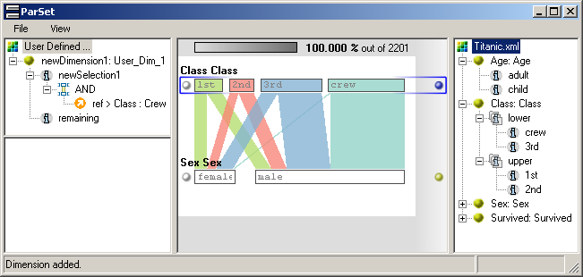
visual encoding
boxes scaled by frequency
color coded by values for current active dimension

Slide 35
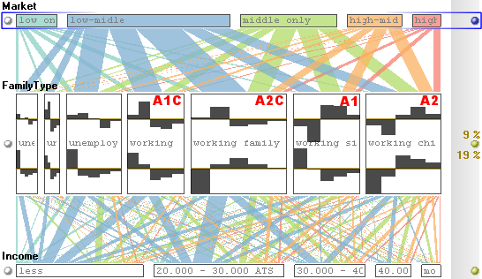
visual encoding
boxes expand to show histogram

Slide 36
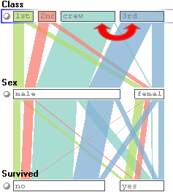
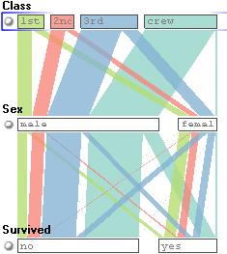
interaction: reorder

Slide 37
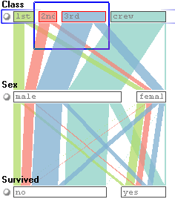
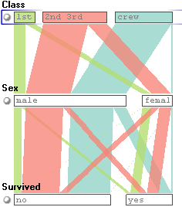
interaction: aggregate

Slide 38
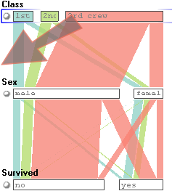
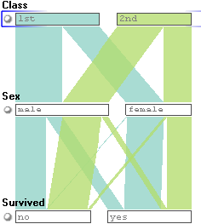
interaction: filter

Slide 39

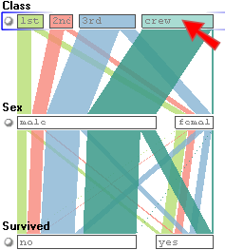
interaction: highlight

Slide 40
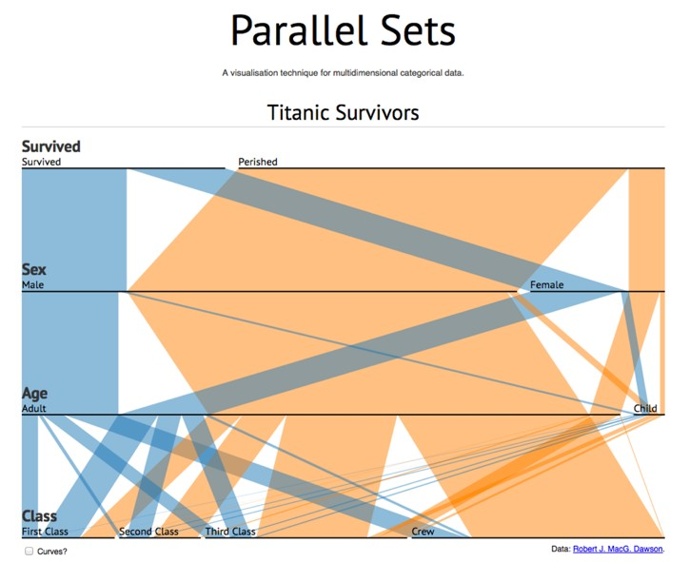
critique: what do you think?

Slide 41
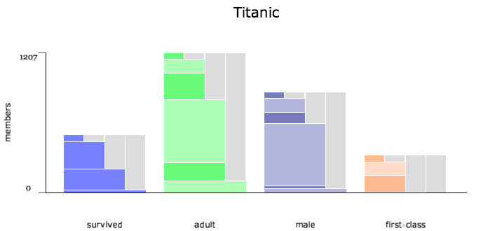
set o’gram

Slide 42
visualizing sets with constraints

Slide 43
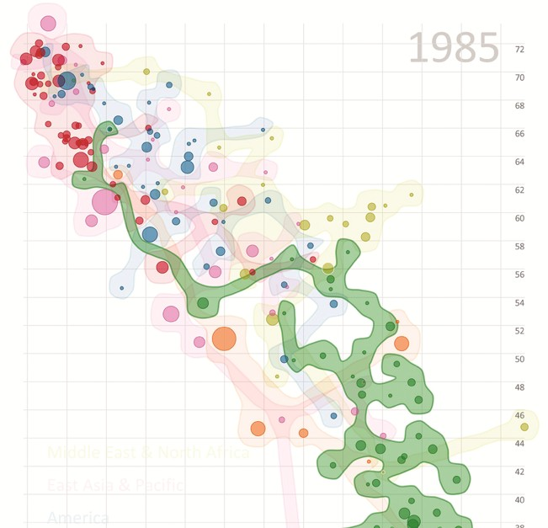
bubble sets

Slide 44
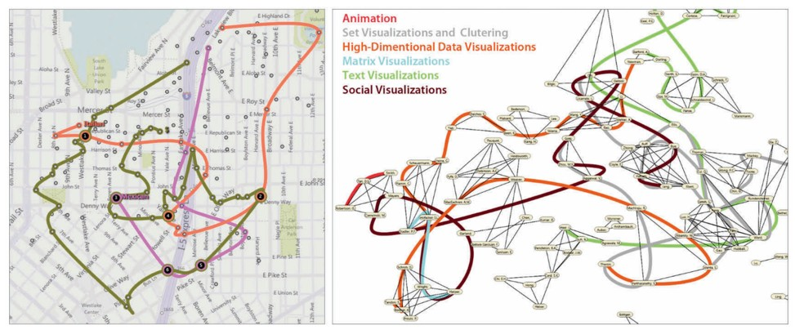
line sets
restaurants
social communities

Slide 45
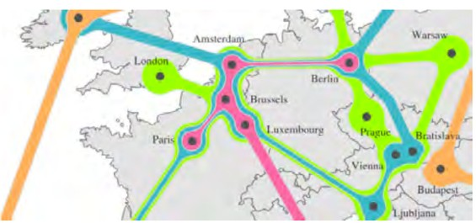
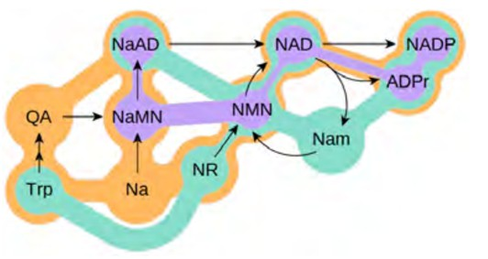
kelp diagrams
metabolic network
cities on a map

Slide 46
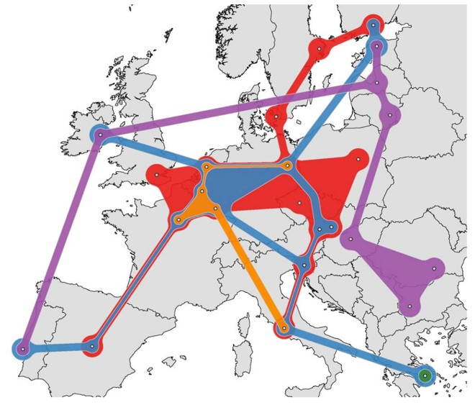
kelp fusion
cities on map
lines & areas

Slide 47
Sets
applies to many datasets
many combinations may be interesting
limited numbers of sets more tractable

